Slide 1
Real vs Fake
By: Yuhao Huo, Weiran Tang, Alex Medina, Deepa Raj
Pod: Heyuannia_Khon/Fuji

Slide 2
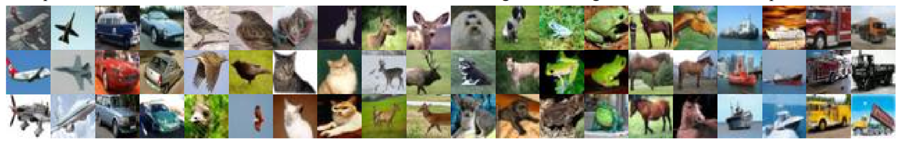

CIFAKE Dataset
Extends CIFAR10.
Uses Latent Diffusion to create a subset using the CIFAR10 as input.
120000 images (32x32x3 RGB)
60000 fake images
60000 real images
2 classes only: FAKE and REAL
100,000 images for training
(50k per class)
20,000 for testing
(10k per class)

Slide 3
Existing Investigations
CIFAKE: Image Classification and Explainable Identification of AI Generated Synthetic Images
Proposes the use of a CNN Network to classify the images
Implements examiable AI via Gradient Class Activation Mapping
Reveals that the model uses visual imperfections in background
CNN-Generated Images Are Surprisingly Easy to Spot… for Now
Train an image classifier (based on ResNet) on one specific CNN generator (pro-GAN)
It is able to generalize surprisingly well to unseen datasets and training methods
What Makes Fake Images Detectable? Understanding Properties that Generalize
Classifier relies on patches such as hair, background, clothing, and mouths to make decisions.

Slide 4
Hypothesis
Question:
Can we differentiate AI generated images from real images through a compact CNN network (not ResNet or GANs), if so, what features does the models based their decisions on?
Hypothesis:
The model classify images based on background features rather than the shape or characteristics of the object.

Slide 5
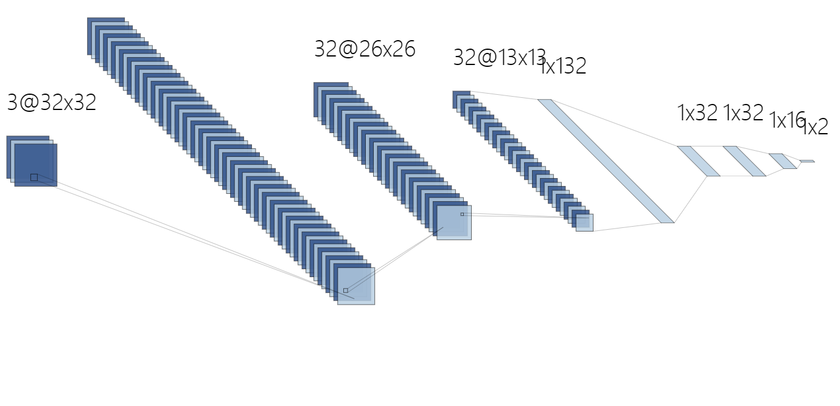
Model
A compact CNN network:
With 320,914 parameters
Architecture:
Convolutional layer: 64 kernels (5x5), stride = 1, padding =2
Convolutional layer: 32 kernels (3x3), stride = 1, padding =2
Pool layer
Fully connected layer: three hidden layers
64@32x32
32@34x34
32@17x17
1x9248
3@32x32
1x32 1x32 1x16
Convolution
Pooling
Flatten
Convolution

Slide 6
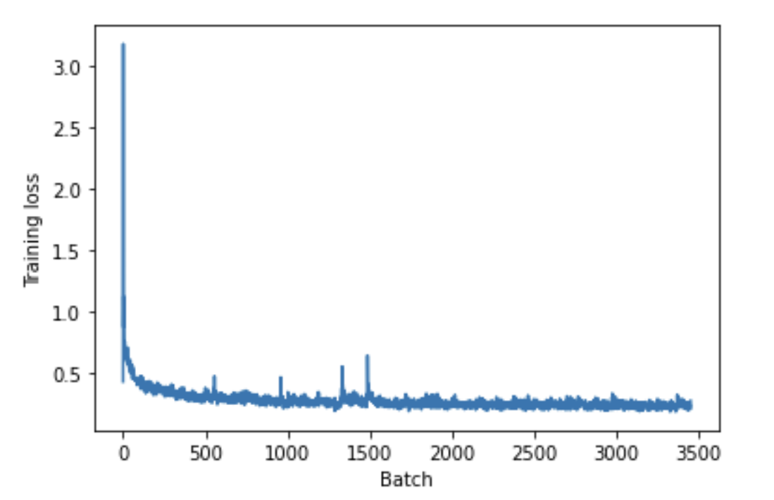
Results
Model achieved following results in training phase:
Train accuracy: 94.38%,
F-score: 0.94
Validation accuracy: 94.66%
F-score: 0.95
Accuracy in testing phase:
Test accuracy: 94.58%,
F-score: 0.95
Batch size = 1600

Slide 7
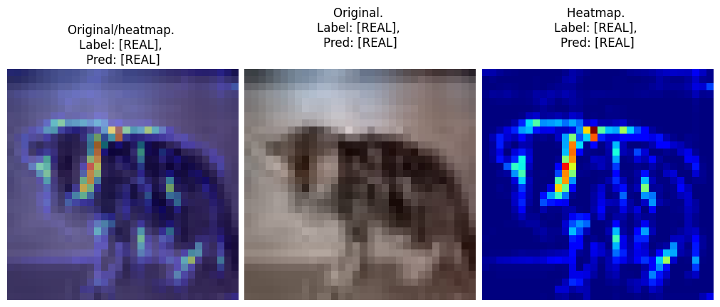
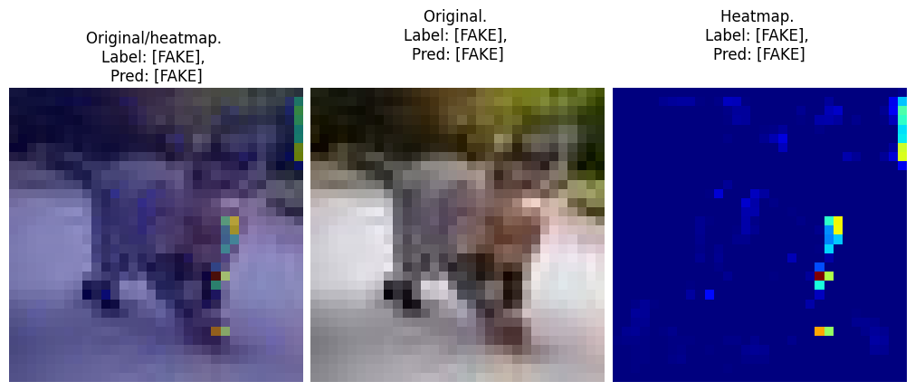
Grad-CAM Analysis
How REAL images are classified:
More activation points
Subject borders are easily identified
Activation points around the image subject
How FAKE images are classified:
Less activation points
Borders cannot be identified
Activation points appear in random places (sometimes in the edges or the background of the image)

Slide 8
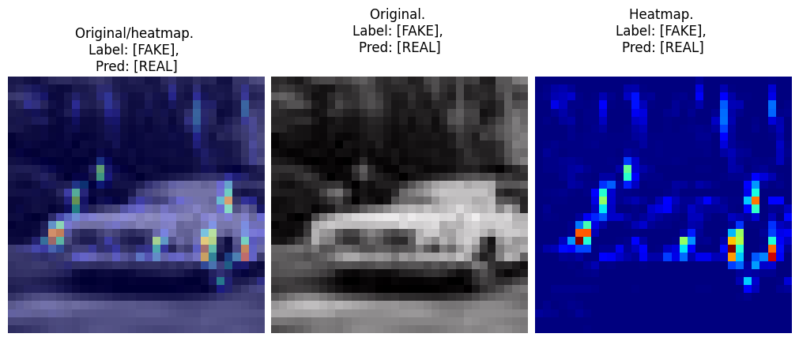
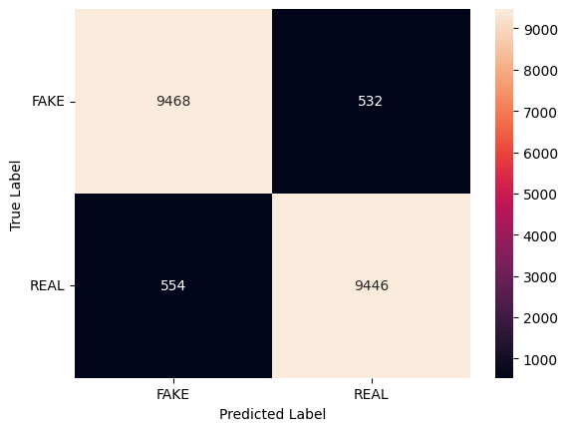
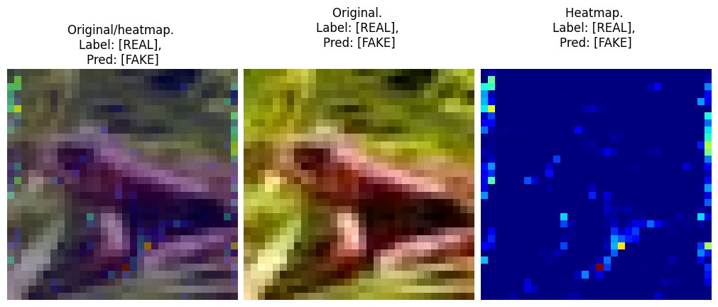
Misclassified images
There is a small percentage of images (around 6%) that get misclassified by the model.
Since the dataset was pretty much well balanced, there is no significant difference between false positive and false negative results

Slide 9
Conclusion
We built a ‘spotter’ that reaches an accuracy of 94% on CIFAKE dataset.
We found that the classifier identify REAL images based on features of the object (such as the outline).
We found that for FAKE images, the classifier relied on less features, and these features can appear both on the object and the background.

Slide 10
References
Bird, J.J., Lotfi, A. (2023). CIFAKE: Image Classification and Explainable Identification of AI-Generated Synthetic Images. arXiv preprint arXiv:2303.14126.
Chai, L., Bau, D., Lim, SN., Isola, P. (2020). What Makes Fake Images Detectable? Understanding Properties that Generalize. In: Vedaldi, A., Bischof, H., Brox, T., Frahm, JM. (eds) Computer Vision – ECCV 2020. ECCV 2020. Lecture Notes in Computer Science(), vol 12371. Springer, Cham. https://doi.org/10.1007/978-3-030-58574-7_7
S. -Y. Wang, O. Wang, R. Zhang, A. Owens and A. A. Efros, "CNN-Generated Images Are Surprisingly Easy to Spot… for Now," 2020 IEEE/CVF Conference on Computer Vision and Pattern Recognition (CVPR), Seattle, WA, USA, 2020, pp. 8692-8701, doi: 10.1109/CVPR42600.2020.00872.
Selvaraju, R.R., Cogswell, M., Das, A. et al. Grad-CAM: Visual Explanations from Deep Networks via Gradient-Based Localization. Int J Comput Vis 128, 336–359 (2020). https://doi.org/10.1007/s11263-019-01228-7

